Slide 1

Bike Repair Project
IEOR 4418: Transportation Analytics & Logistics
Emily Labattaglia | Lars Patrik Roeller | Kostas Valaris
Fall 2016

Slide 2
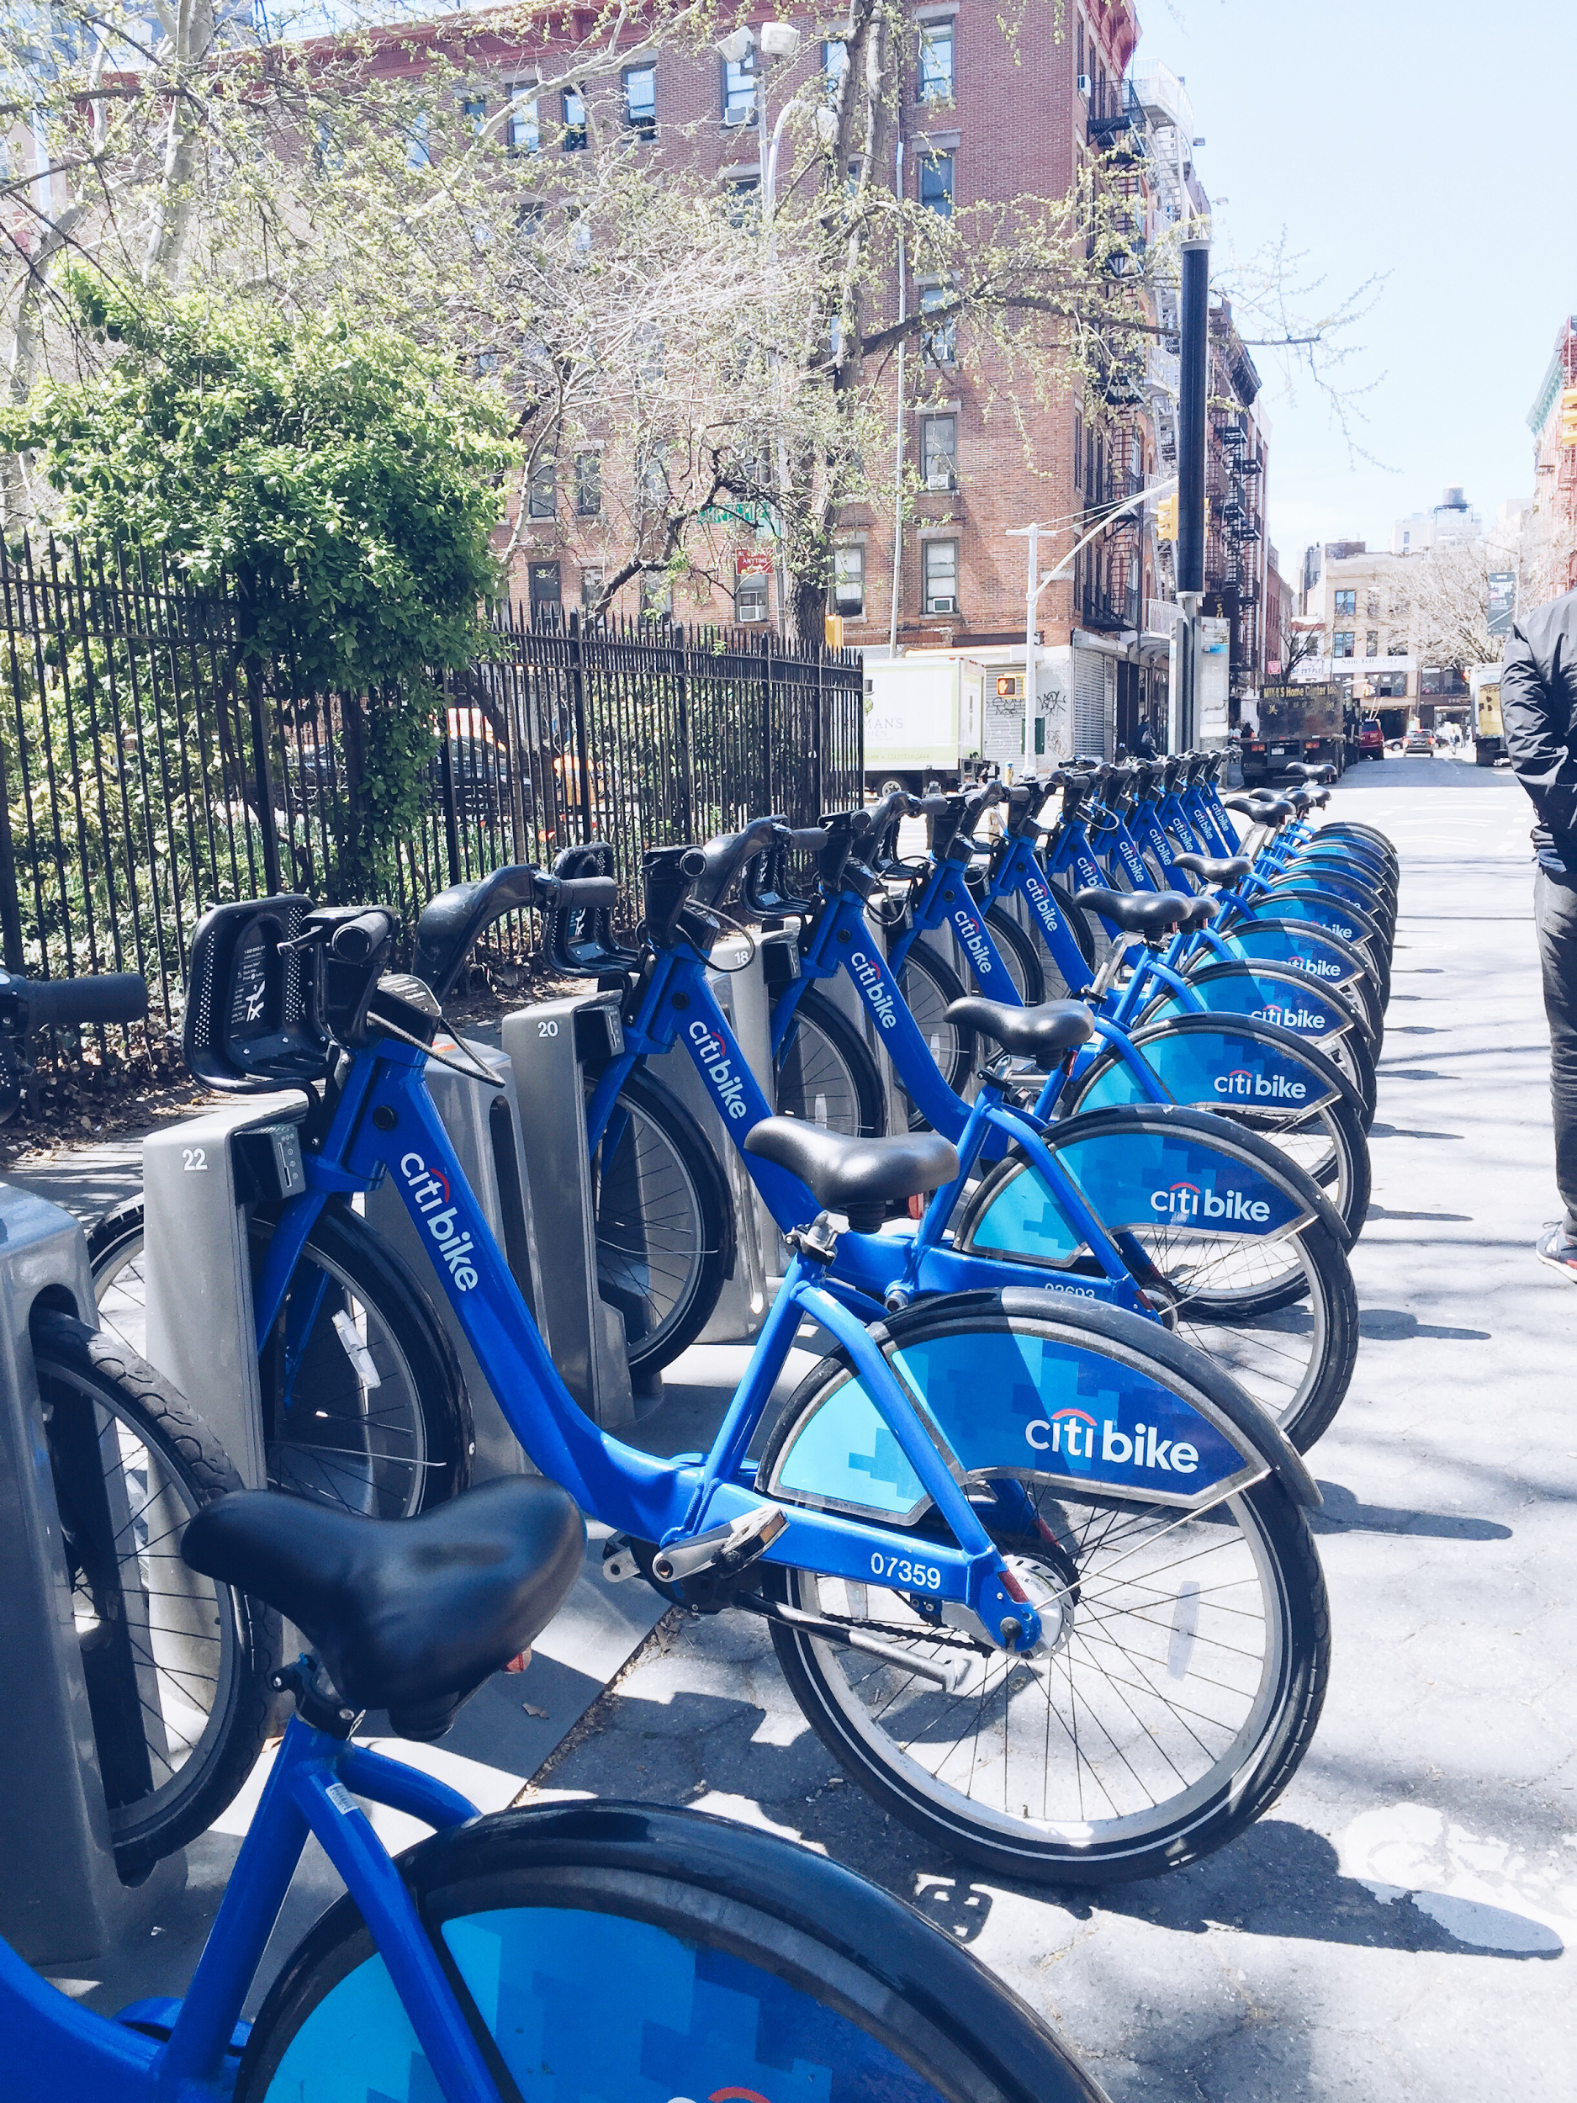
Outline
Current System
Modeling Framework
Methodology
Analysis
Solution

Slide 3
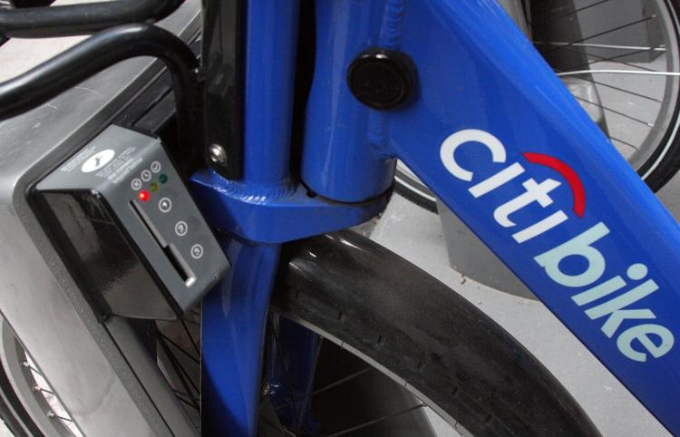
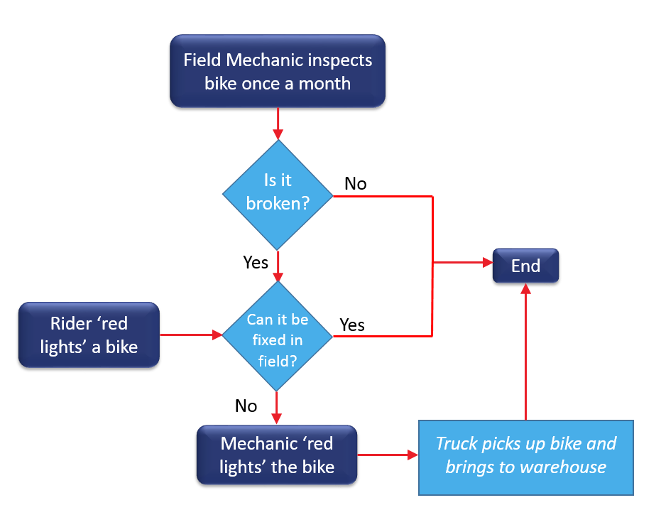

Citi Bike’s Current System

Slide 4
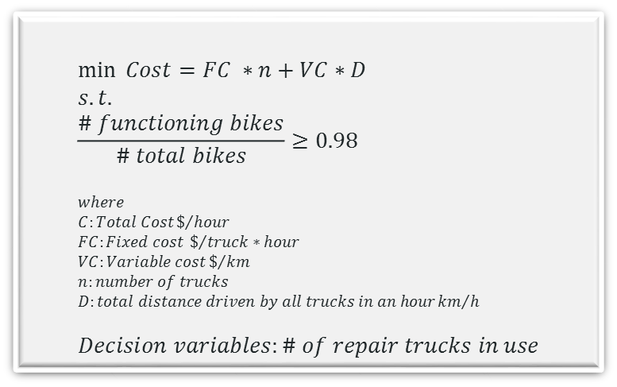
Modeling Framework
Objective: find the optimal number of trucks to use in the repair process
Optimization Problem
$$\min{ Cost=FC ∗n+VC∗D} \\ s.t. \\ \frac{\# functioning bikes}{\# total bikes}≥0.98 \\ where \\ C:Total Cost\$/{hour} \\ FC:Fixed cost \$/{truck∗hour} \\ VC:Variable cost\$/{km} \\ n:number of trucks \\ D:total distance driven by all trucks in an hour{km}/h \\ Decision variables:\# of repair trucks in use$$

Slide 5
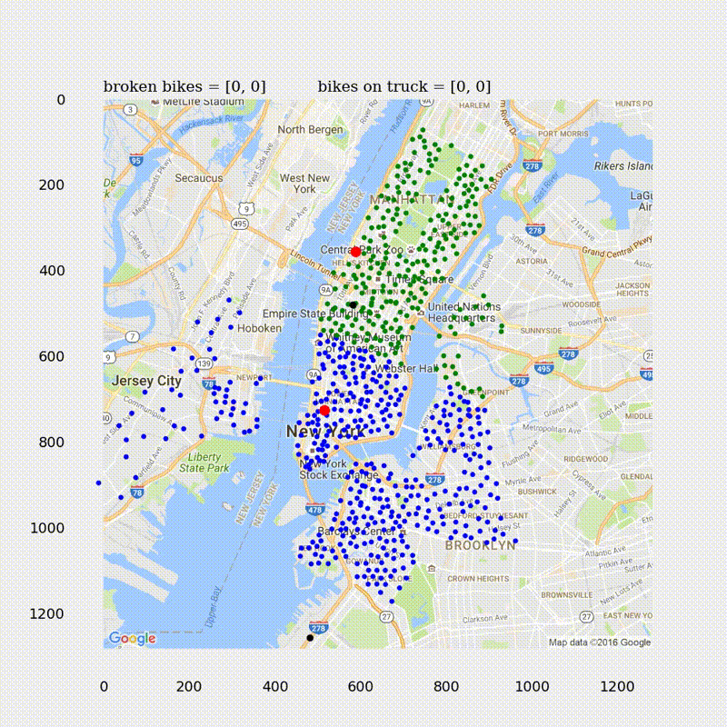
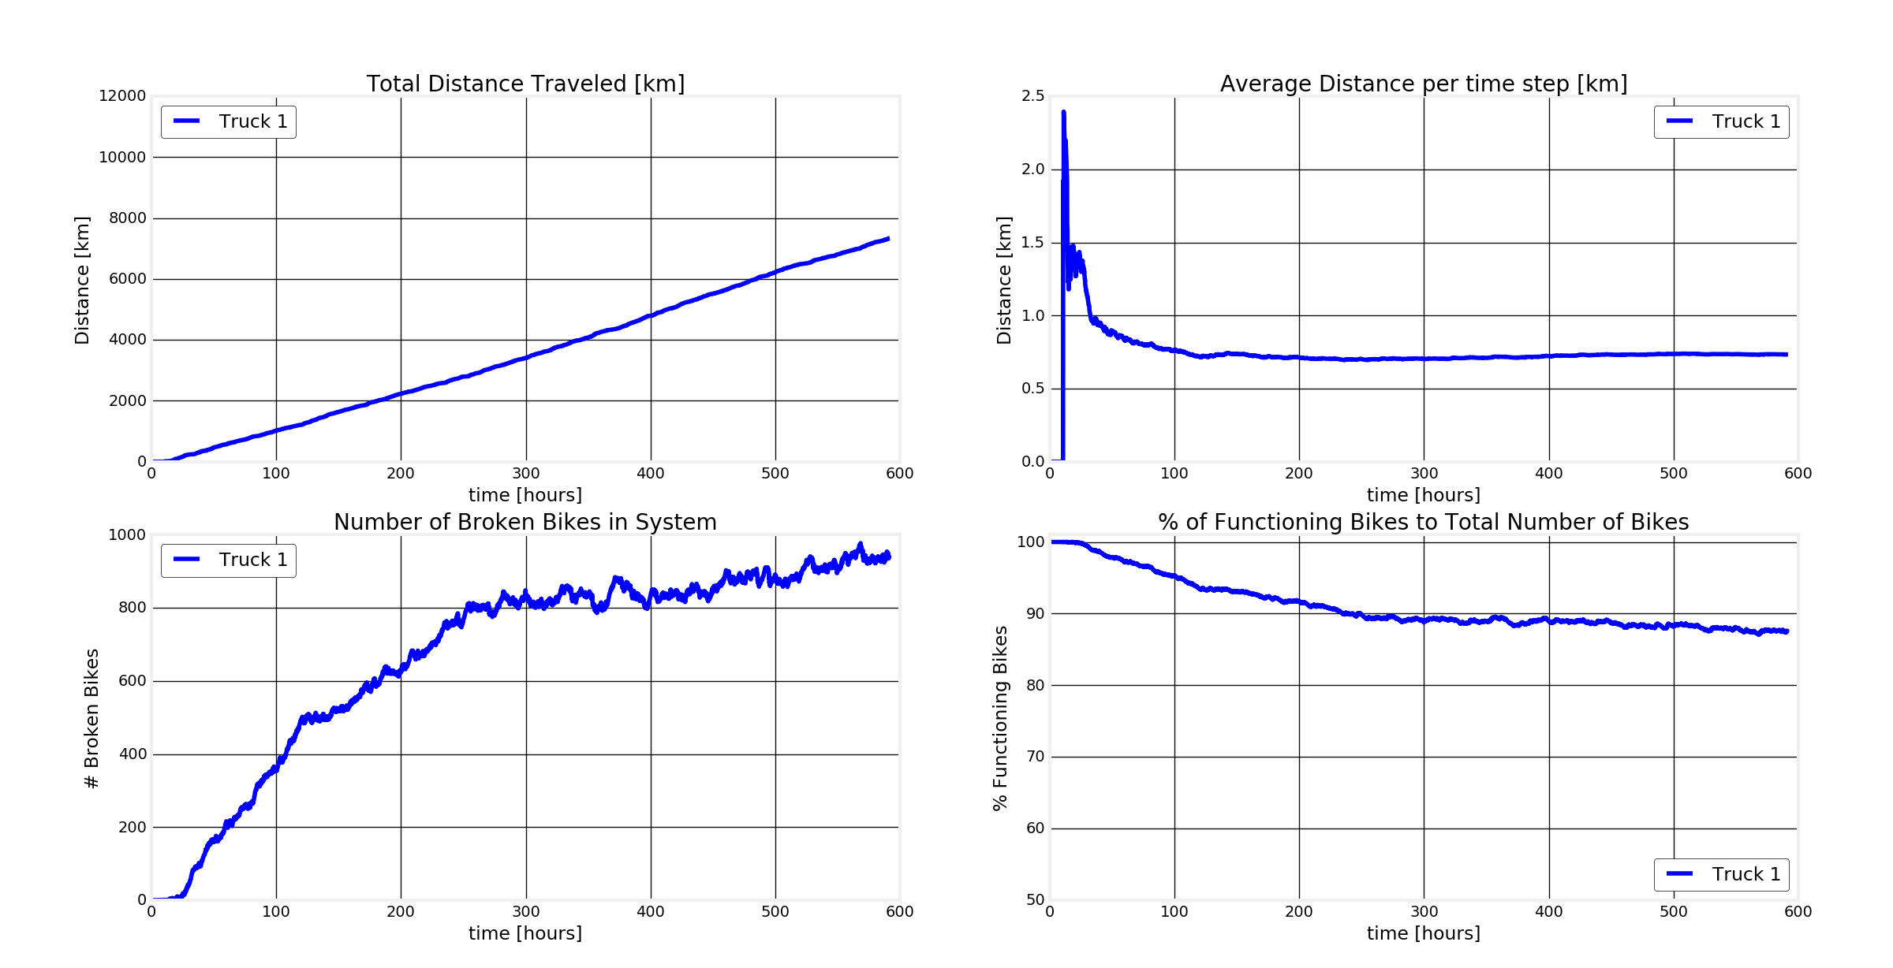
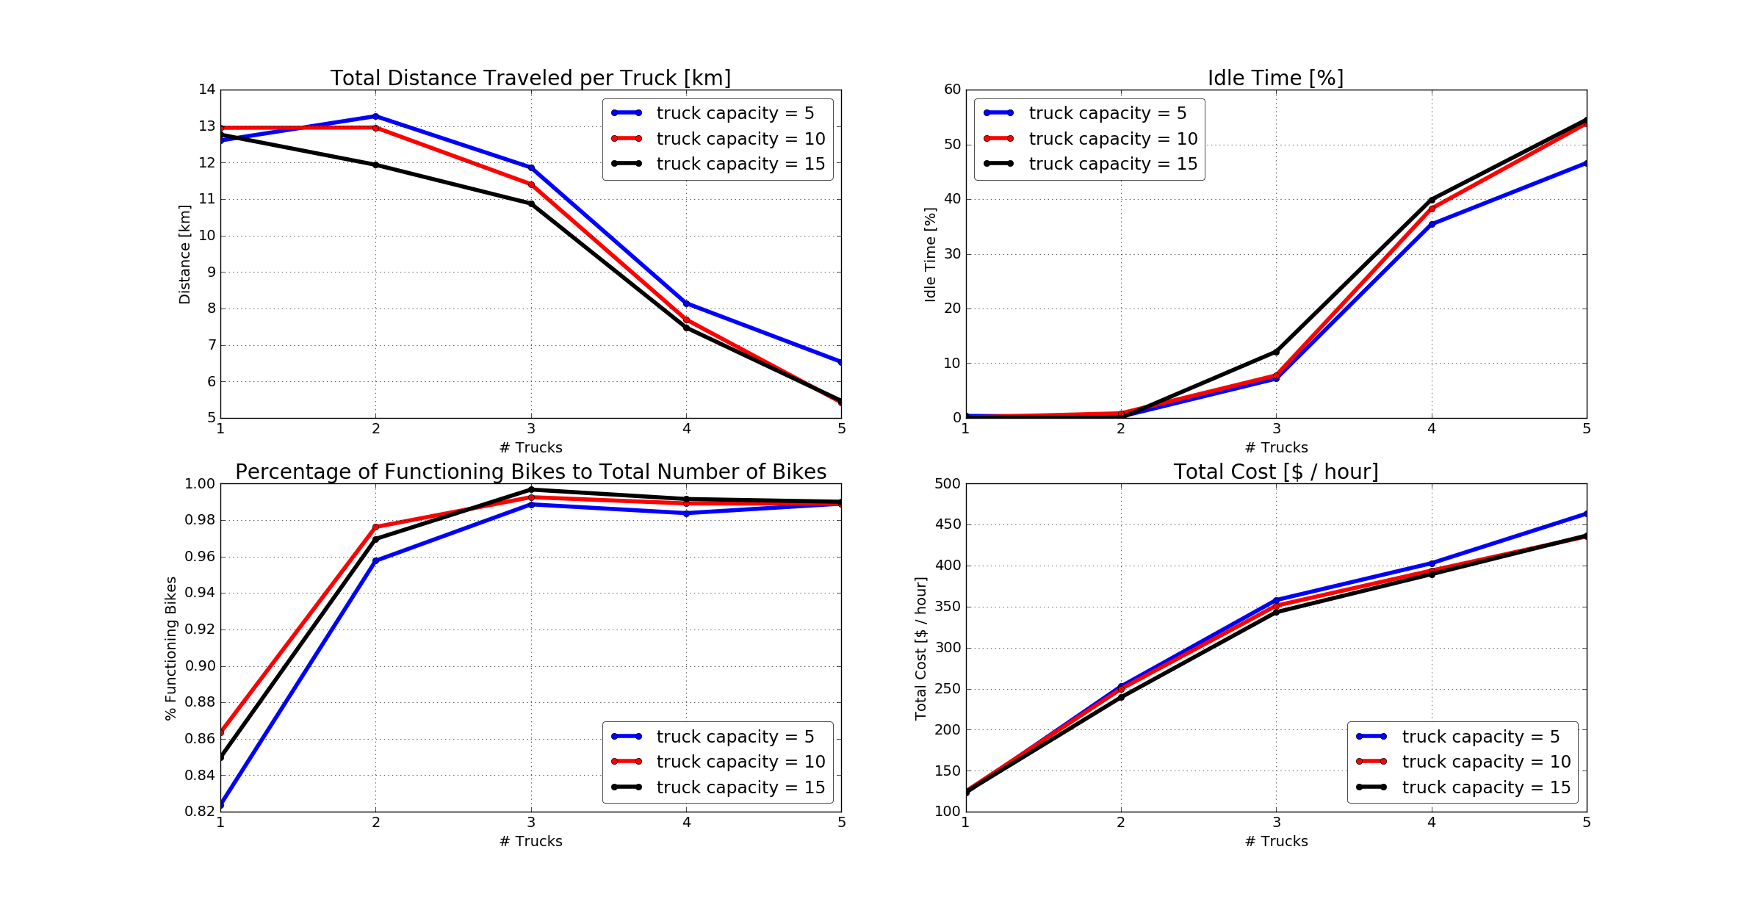
Methodology
Discrete Event Simulation
Model bike breakdowns Model truck movement Trucks drop off bikes at repair stations when full
Run Simulation until solution converges
Look at data in last n hours of simulation
Repeat Simulation runs for varying # trucks
Notes:
-- explain to recreate/execute combine with psuedocode and discrete event simulation

Slide 6
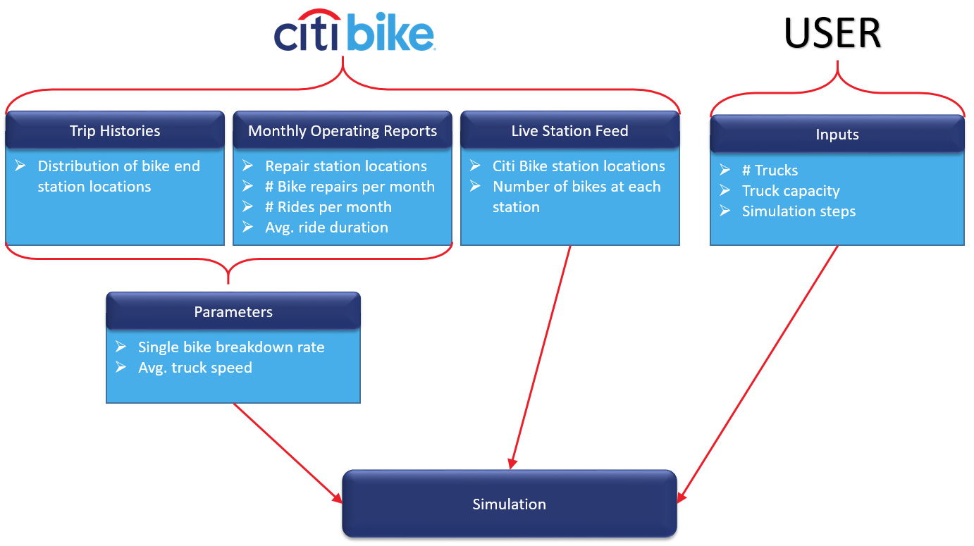
Methodology – Data, Inputs, Parameters

Slide 7
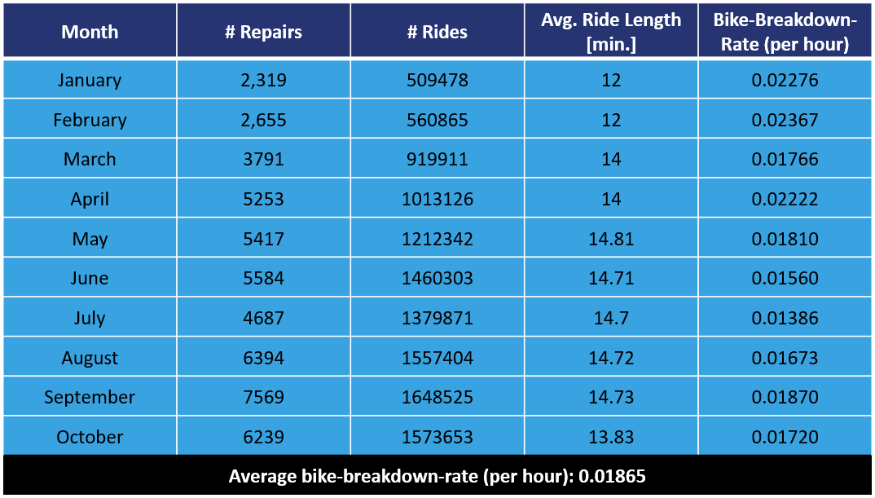
Methodology – Parameter Estimation
Rate of bike breakdowns
Average travel speed
“In 2014, [average vehicle speed in Manhattan] dropped to 8.51 MPH.”
Source: http://www.wnyc.org/story/traffic-speeds-slow-nyc-wants-curb-car-service-growth/
Source: Citi Bike Monthly Operating Reports
Notes:
Bike breakdown rate per station is sum of bikes going to station at an instant times bike breakdown rate for respective month

Slide 8
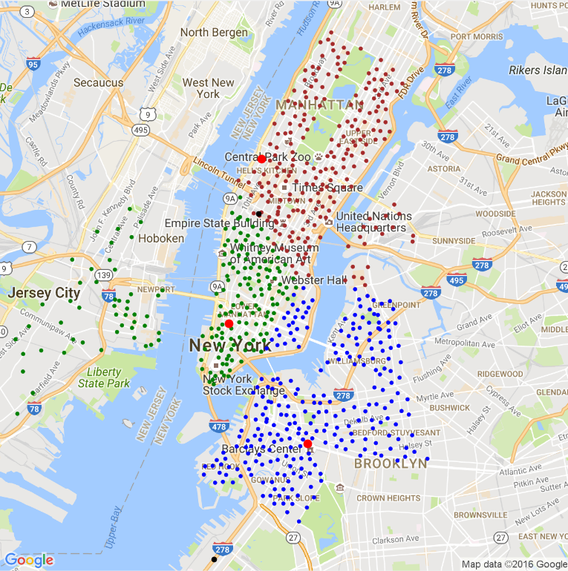
Methodology – Code Sequence
Use K-Means clustering to assign trucks to stations
Assign closest repair station to each cluster
Loop
Simulate next breakdown times and truck arrival times
Find minimum time and update simulation to that time
Plot updated state of simulation
If truck capacity is reached, set next destination to repair station location
The next station to visit is the one with the most number of broken bikes

Slide 9
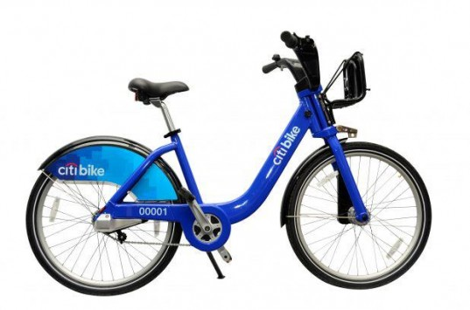
Analysis
Long-Run Simulations

Slide 10
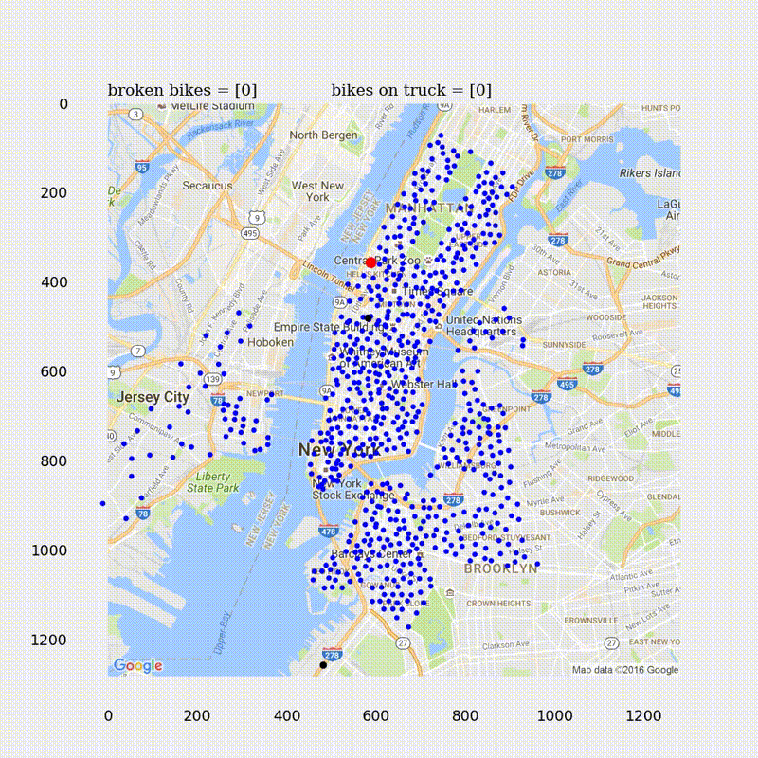
One Truck in the Afternoon
Placeholder for video
Notes:
Converges after about 200 hours
No idle time
% of functioning bikes is about 90%
Afternoon solution should be more than 90%

Slide 11
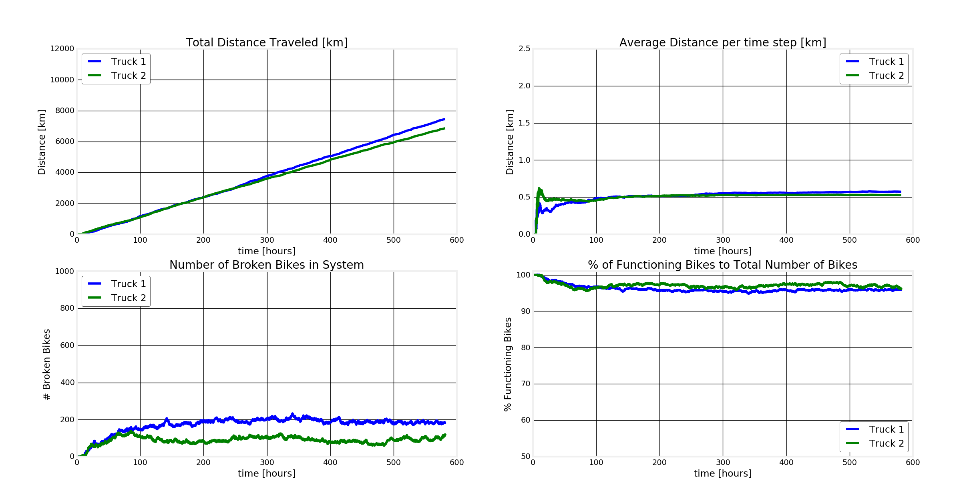
Two Trucks in the Afternoon
Notes:
Converges
Number functioning bikes is about 95%
Need more trucks

Slide 12
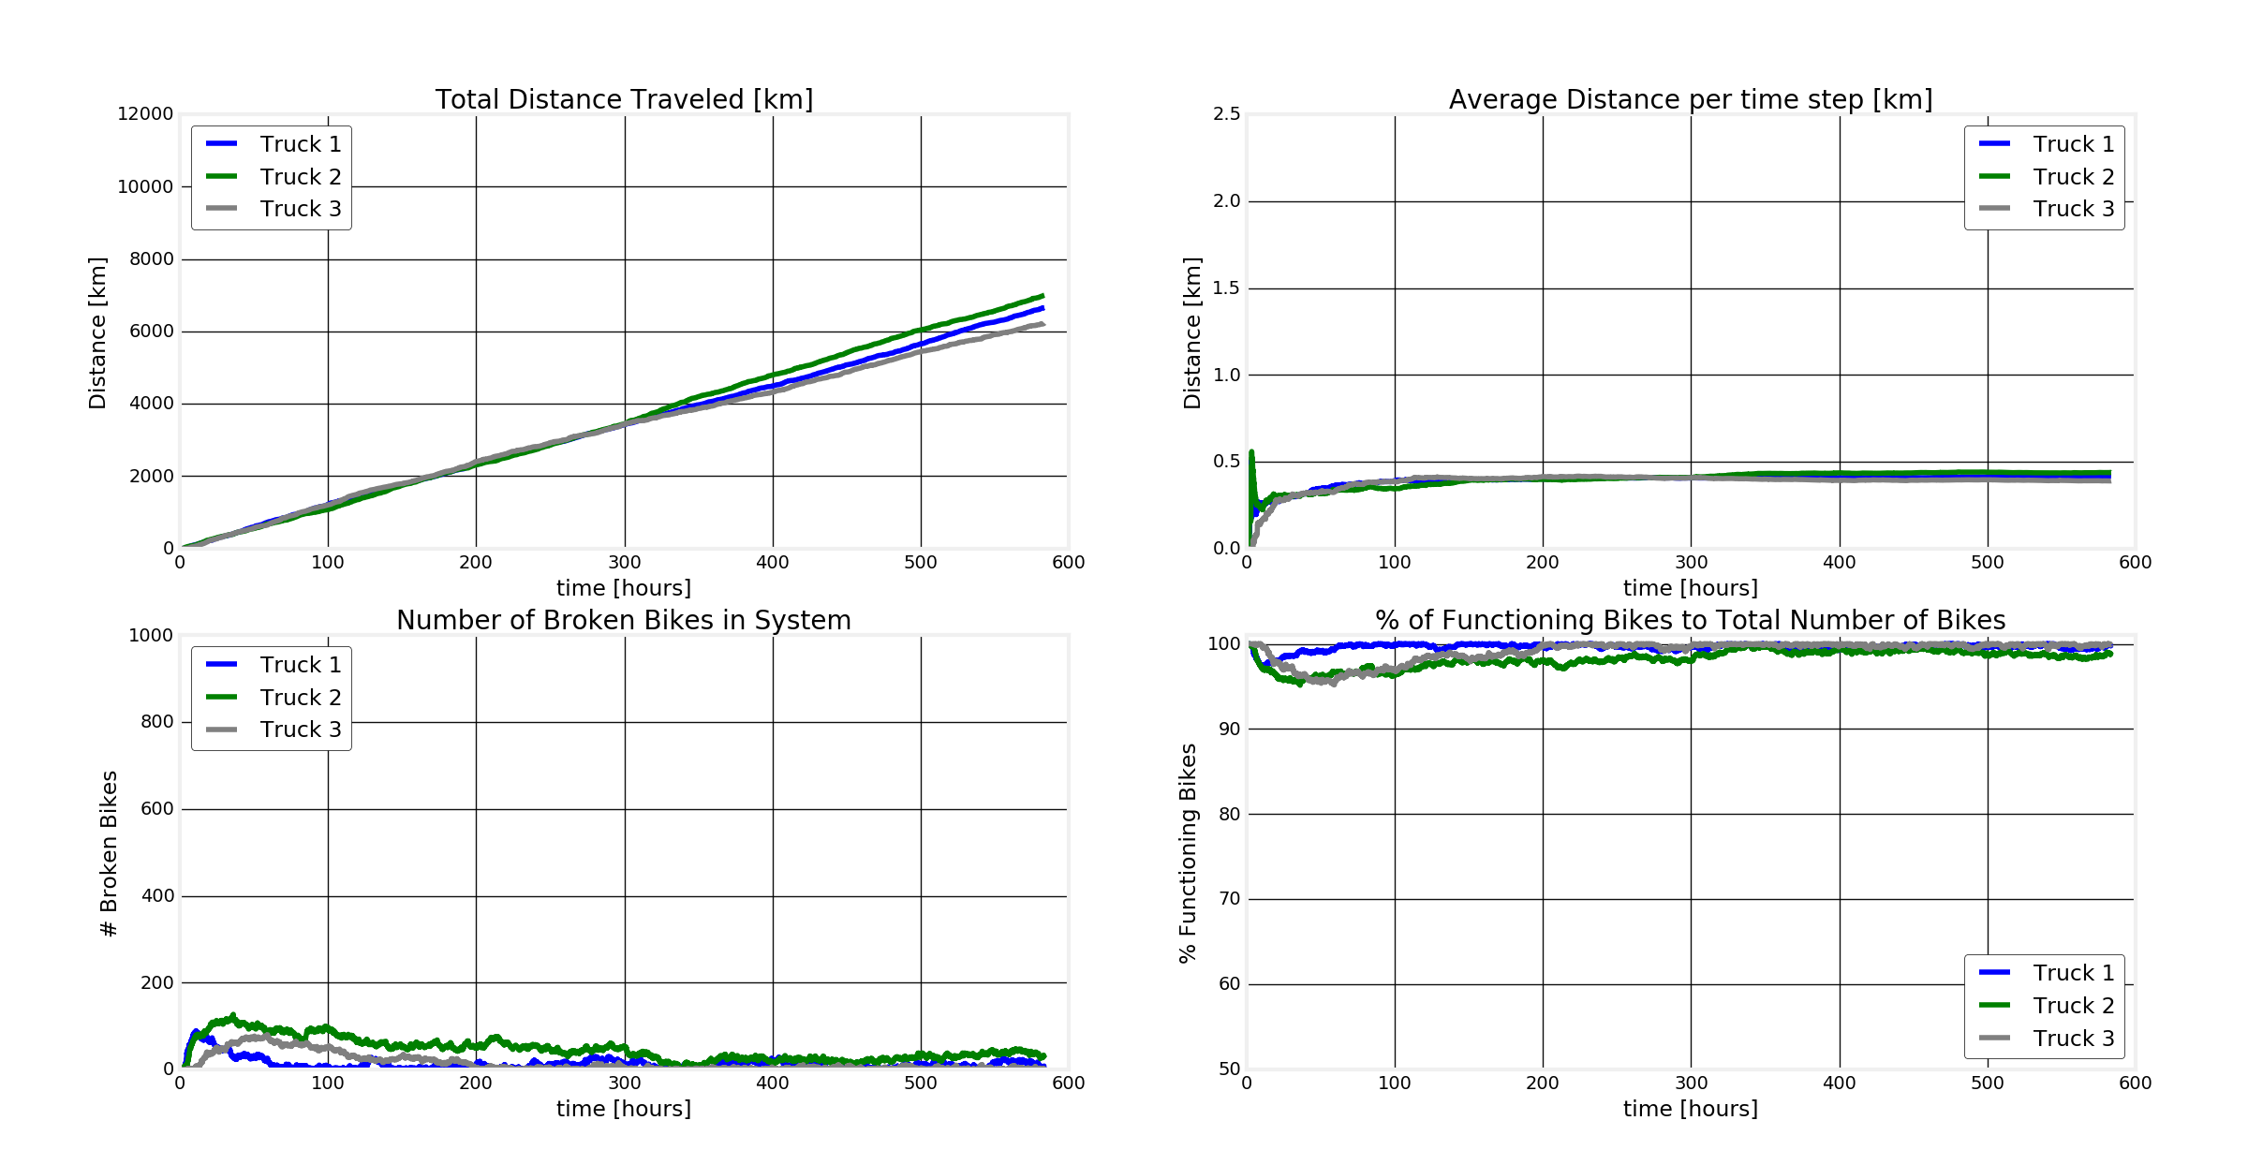
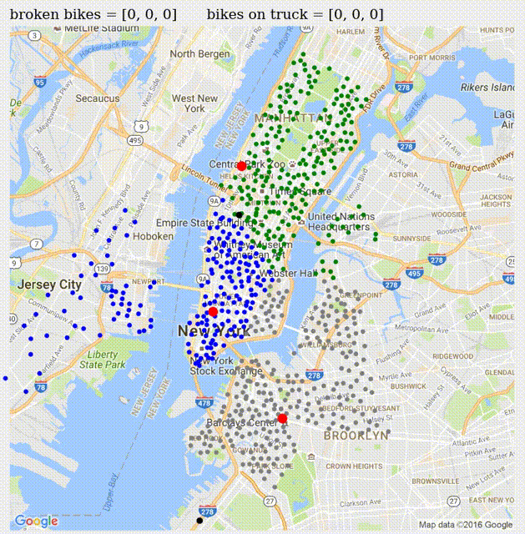
Three Trucks in the Afternoon
Notes:
Converges
Almost 100% functioning bikes
Definitely good enough

Slide 13
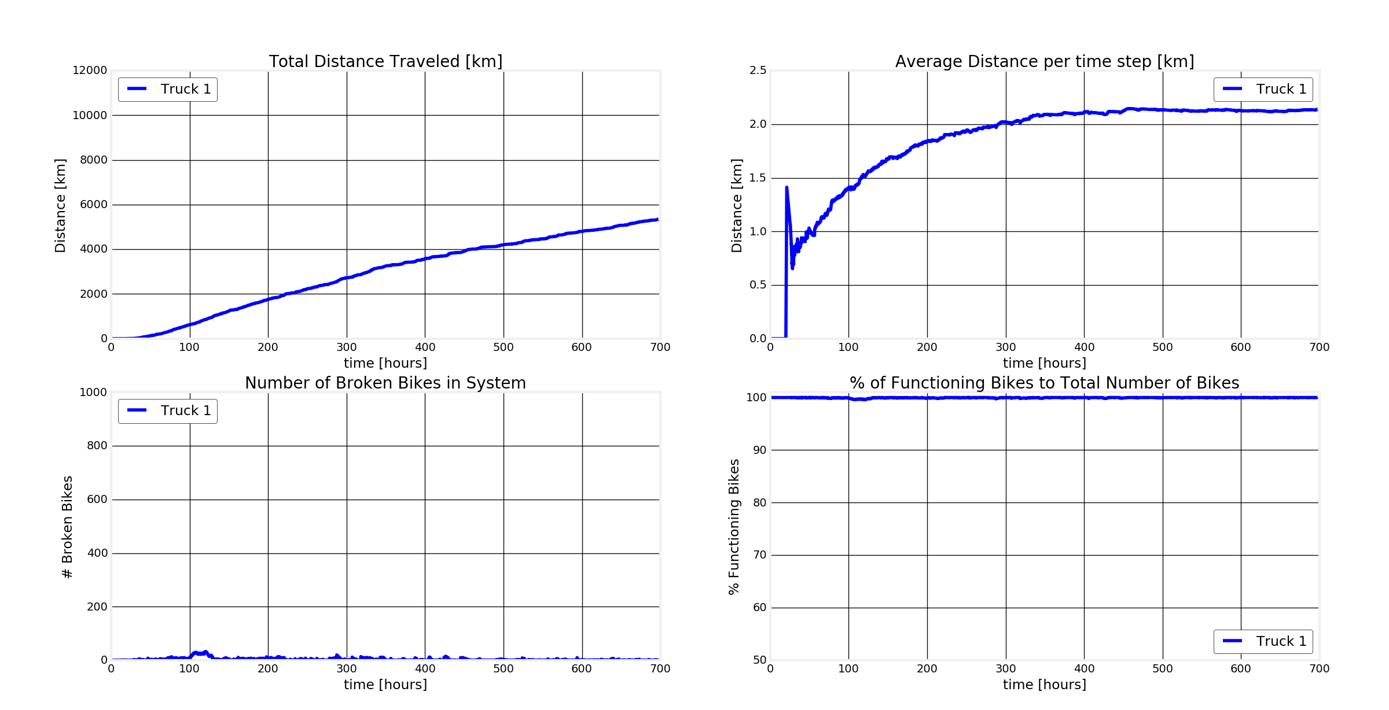
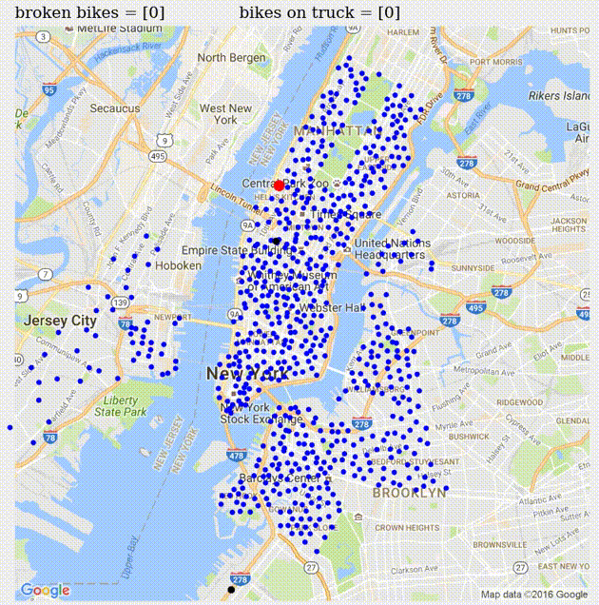
One Truck at Night
Notes:
Converges
1 truck at night is enough

Slide 14
Analysis
Sensitivity Analysis

Slide 15
Varying Truck Capacity
Notes:
Color code: blue = 5, red = 10, black = 15
X-axis: # trucks in use
Explain all graphs when you get here
Truck capacity is not an important factor for smaller number of trucks
% of functioning bikes stays constant for anything more than 10 truck cap

Slide 16
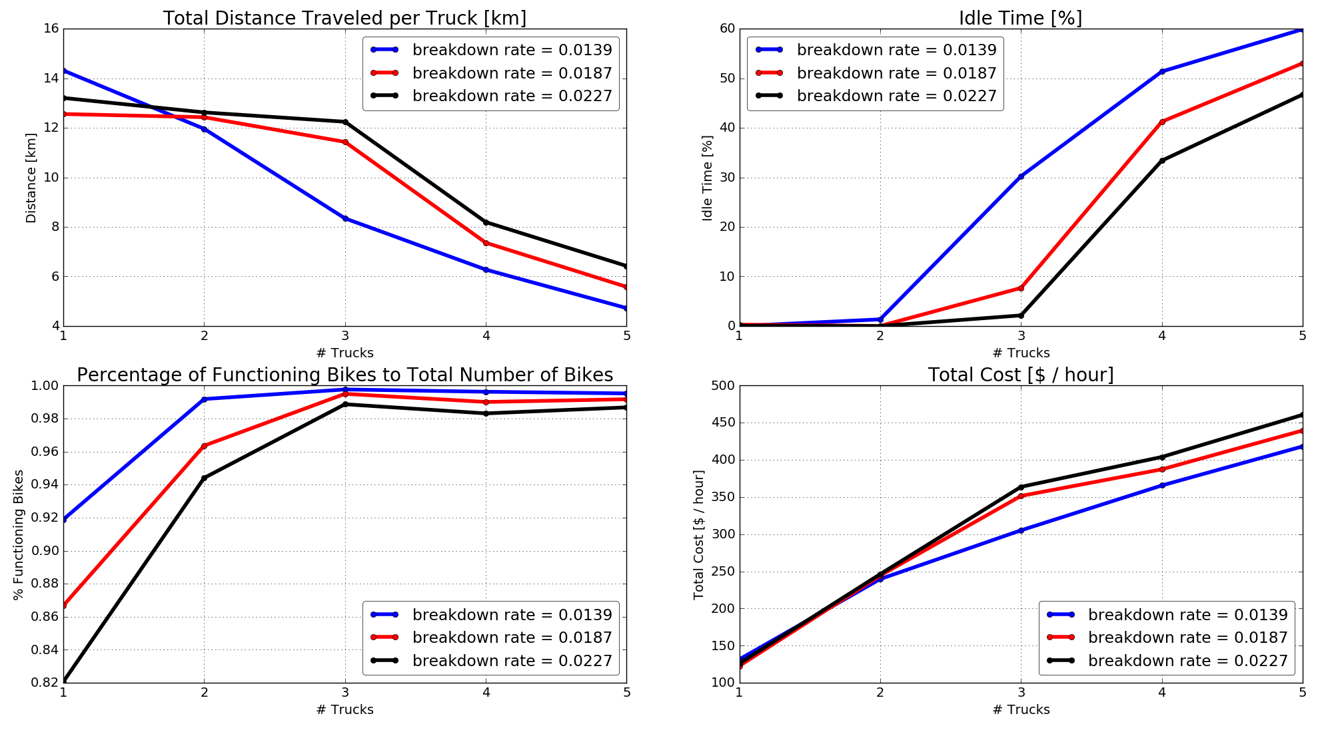
Varying Breakdown Rate
Notes:
Color code: blue = 0.0139, red = 0.0187, black = 0.0227 [why these 3 particularly again?]
[colors represent different rates; x-axis still # of trucks] -- here optimal # trucks = 3
Total distance initially same because idle time is 0% -- do we have to account for the time the mechanic makes the actual repair that truck is idle?
Once idle time above 0% travel distance per truck decreases for larger idle times
Cost increases at a smaller rate for smaller lambda once idle time increases
Optimal solution: 3 trucks for afternoon

Slide 17
Solution
To maintain functioning bikes at stations above 98%:
→ Optimal # of trucks per time of day:
Afternoon: 3 trucks
Night: 1 truck

Slide 18
Thank you.
Questions?
Emily Labattaglia | Lars Patrik Roeller | Kostas Valaris

Slide 19
Model Assumptions
Only broken bike pick-ups are modeled
Trucks proceed to station with most number of broken bikes
Exponentially distributed interarrival times at stations
Exponentially distributed travel times for each truck
Travel time depends on direct distance between citi bike locations
Fixed cost per truck is 60 $/(truck*hour), variable cost is 5 $/kilometer
Notes:
*accounts for checked bikes & picked up bikes

